Slide 1

ENGG404 Lecture Chapter 7.2: Leadership – What Makes an Effective Leader?
Fundamentals of RM
RM System and Process
Leadership in RM
Incident Investigation
RM Tools & Challenges
RM in Industry
People & Org.
Application and Perspectives
On becoming a leader in risk management
1

Slide 2
Learning Outcomes:
Explain the concept of “Leadership” in the context of business.
Explain and diagram “Our Personal Iceberg” Model, and why it is critically important that our actions are consistent with our intentions.
Begin a process to determine your personal values.
Analyse a basic scenario with alternative choices, and determine the values on which those choices are based.
Discuss and explain that good leadership is founded on good values:
Explain the importance of the organization’s values, the leader’s values, the leader’s intentions, and the leader’s actions, and for effective leadership that those actions are consistent with those intentions.
Key Lesson: Leaders make things happen (in a good way) that would not have happened otherwise.
Chapter 7.2: Leadership - What Makes an Effective Leader?
2

Slide 3
Are Leaders “Born” or “Made”?
Two theories of the “making” of effective leaders have evolved:
Trait-based models – “leaders are born”.
Behaviour-based models – “leaders can be made trained”.
Think of any “leaders” you know and discuss this question with your colleague: Was your perspective of those leaders that they were:
“Born leaders?”
“Trained leaders?”
Research, beginning well over 50 years ago, supports that leaders can be trained.
This lecture aims to explore these universal questions:
What is leadership? Effective leadership?
What makes a great leader?
Why does it matter?
Chapter 7.2: Leadership - What Makes an Effective Leader?
3

Slide 4
Q: What is Effective Leadership?
Significant experience condensed a vast study of leadership:
“Leadership is the use of power and influence to direct the activities of followers toward goal achievement.
To accomplish this, a leader is entrusted with people and resources to add value to the business in a principled (legal, ethical, moral) way.
A leader adds value by supporting their employees in a team or business unit so that they can do their jobs better.”
Gord Winkel, 2013.
Do we now understand the meaning of the key phrases?
It could be further condensed as: Leaders make positive things happen in a principled manner that would not have otherwise happened.
Chapter 7.2: Leadership - What Makes an Effective Leader?
4

Slide 5
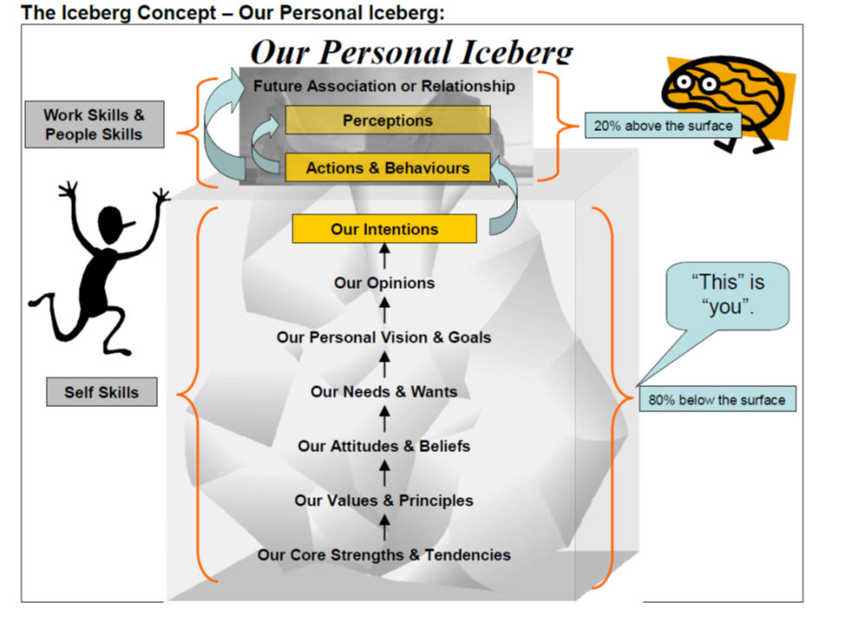
The “Personal Iceberg Model” and Effective Leadership:
This is what people “see about you”.
Chapter 7.2: Leadership - What Makes an Effective Leader?
5
Notes:
5
People – your superiors, your peers, and your subordinates – see your actions and your behaviours.
They cannot know what you are thinking, or know any of the underlying opinions, goals, needs and wants, attitudes, values and principles, and core strengths – unless you explicitly inform them! And that would take a lot of time and effort, not only because there is a lot to communicate in a clear and succinct terms, but also because we have a difficult time determining, defining, refining, and articulating the same list!
Because they cannot know, it is critically important for us in our leadership role to ensure that our actions and behaviours are exactly aligned with our intentions.

Slide 6
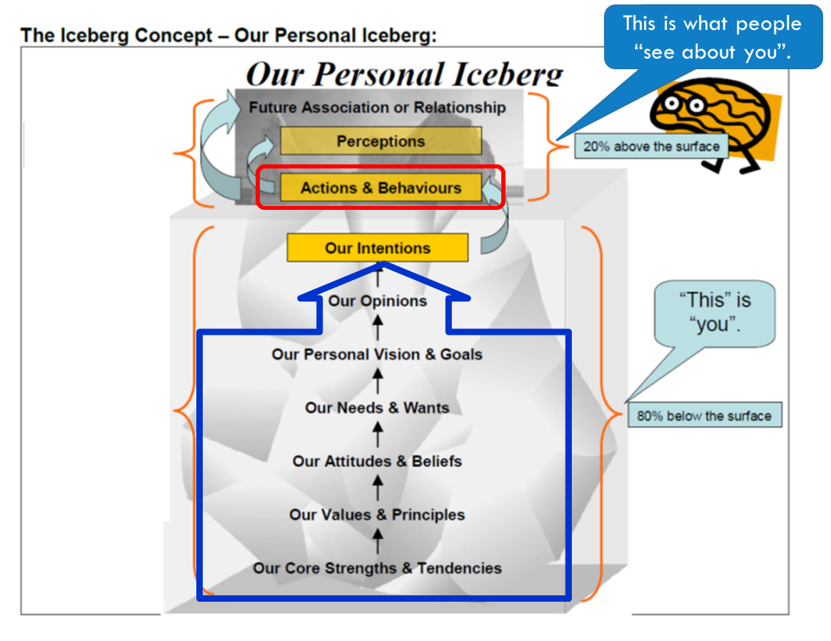
The “Personal Iceberg Model” and Effective Leadership:
People – your superiors, your peers, and your subordinates – see your actions and your behaviours.
This is “their perception of you” or “how they perceive you”.
They cannot know what you are thinking, or know any of your underlying opinions, goals, needs and wants, attitudes, values and principles, and core strengths – unless you explicitly inform them!
And that would take a lot of time and effort, not only because there is a lot to communicate in a clear and succinct terms, but also because we have a difficult time determining, defining, refining, and articulating the same list!
Because they cannot know, it is critically important for us in our leadership role to ensure that our actions and behaviours are exactly aligned and consistent with our good intentions.
Chapter 7.2: Leadership - What Makes an Effective Leader?
6
Notes:
6
People – your superiors, your peers, and your subordinates – see your actions and your behaviours.
They cannot know what you are thinking, or know any of the underlying opinions, goals, needs and wants, attitudes, values and principles, and core strengths – unless you explicitly inform them! And that would take a lot of time and effort, not only because there is a lot to communicate in a clear and succinct terms, but also because we have a difficult time determining, defining, refining, and articulating the same list!
Because they cannot know, it is critically important for us in our leadership role to ensure that our actions and behaviours are exactly aligned and consistent with our good intentions.

Slide 7
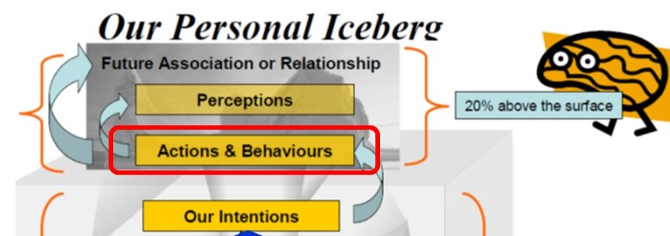
The “Personal Iceberg Model” and Effective Leadership:
1) Our intentions are manifested as our actions & our behaviours.
2) People see you for what your actions and behaviours are!
Your intentions and an opportunity for self-reflection.
Recall any situation …
Were others’ perceptions of you different than your intentions?
Example?
7
Notes:
7

Slide 8
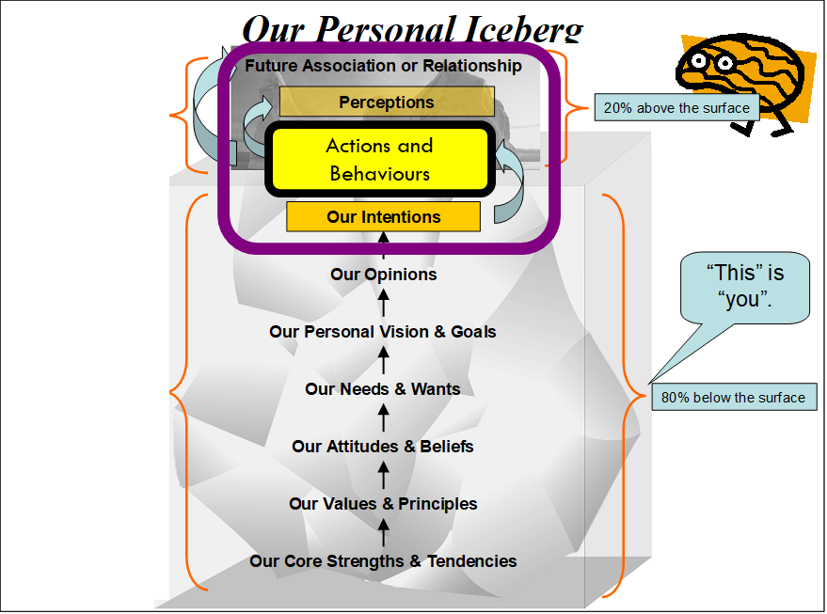
The “Personal Iceberg Model” and Effective Leadership:
The Golden Rule for all relationships:
Dignity, respect, and integrity in your interactions with your supervisors, peers, and subordinates are essential for building and maintaining effective relationships.
“Treat others like you want to be treated.”
Chapter 7.9: Practical Ways to Build A Safety Culture
ESRM - LRM
8
Notes:
8

Slide 9
What are Values? What are Your Values?
From Our Personal Iceberg discussions, “We are who we are” is a result of the values we have developed early in our lives, and as we purposefully change our values as we grow, adapt, and mature.
These values become the basis for how we prioritize, for how we make decisions, for “how we do work around here”.
Depending on our period of life experience, these values and dimensions may be influenced very differently, and they share prevailing paradigms in society and the workplace.
“Values are those things that really matter to each of us ... the ideas and beliefs we hold as special. Caring for others, for example, is a value; so is the freedom to express our opinions.” BSA
9
Notes:
9

Slide 10
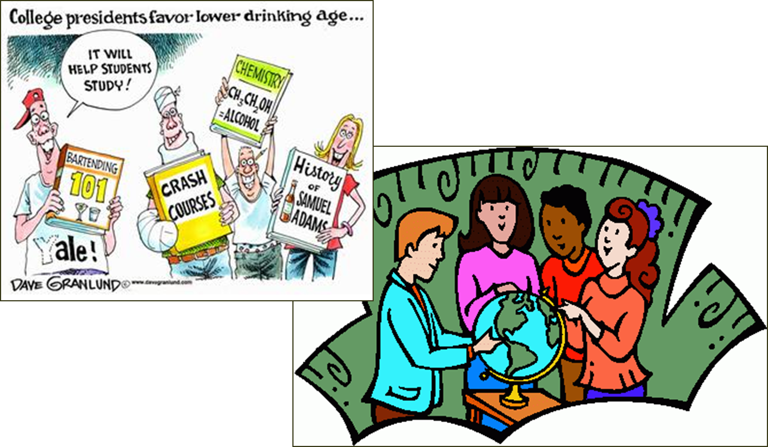
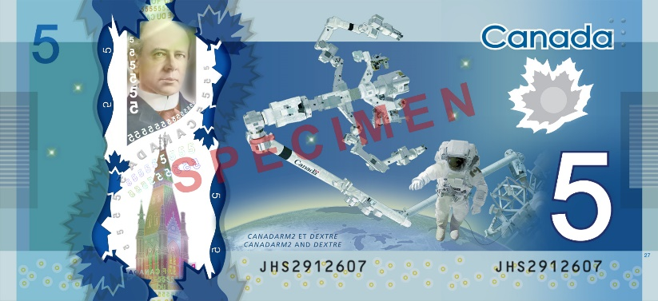
What are Values? What are Your Values?
Values:
Determine or set your priorities …
Are the basis on which you make decisions …
Recall the discussion about two study groups?
… the discussion about the Professor walking through the ETLC and finding a $5 bill on the floor?
10
Notes:
10

Slide 11
What are Values? What are Your Values?
Discussion: The $5 bill and two scenarios:
Scenario 1) The professor is walking through the empty Food Court early in the morning and sees a $5 on the floor. What does the professor do? On what value(s) are each of these choices based?
The professor actively looks for someone, but seeing as no one is around and there is not even a remote possibility of looking the rightful owner of the $5, the professor pockets the money for either 1) a fresh coffee for or 2) donate to a campus charity.
Scenario 2) The professor is walking through the busy Food Court. The professor observes a student pull out their cell-phone from their pocket, and unbeknownst to the student, a $5 bill falls onto the floor. What does the professor do? What choices does the professor have? On what values are each of these choices based?
The professor quickly scopes up and keeps the $5.
Pick it up and contact the student to return the $5.
11
Notes:
11

Slide 12

What are Values? What are Your Values?
Scenario 1 Options | Scenario 2 Options
Buy fresh coffee: Rightful ownership (attempt) | Pocket the $5: Greed. Dishonest. Lack of integrity
Buy their colleague a coffee Generosity | Return the $5 to the student: Honesty. Rightful ownership of property. Integrity – living by their values.
Donate to Charity Charity | Other choice?
12
Notes:
12

Slide 13
What are Values? What are Your Values?
Deep down, values are probably the measures you use to tell if your life is turning out the way you want it to.
When the things that you do and the way you behave match your values, life is usually good – you're satisfied and content.
But when these don't align with your values, that's when things feel... wrong. This can be a real source of unhappiness.
This is why making a conscious effort to identify your values is so important.
Take some time in your career to develop and crystallize YOUR values!
13
Notes:
13

Slide 14
Good Leadership Is Founded On Good Values:
Values are essential for effective leadership, for the good of the organization and the workers.
Leaders promote values that have meaning for team members and will encourage norms of safe behaviour.
Examples of values of a Team:
Accountability:
Collaboration:
Empowerment:
Consistency:
Community i.e. “Togetherness”:
Youtube Video: Learn how to Identify Values and Beliefs; mm:ss 02:15; https://www.youtube.com/watch?v=Kz__qGJmTMY
14
Notes:
14

Slide 15
The Personal Iceberg, Effective Leaders, and Their Values:
The Leader’s actions and behaviours – “Lead by Example”, “Walk the Talk” – must be consistent with their intentions, and their intentions are founded on values!
Through their actions, the leader’s values shape the vision and culture, by providing the foundation for ‘who we are’ and ‘how we do things around here’.
Thus, it is important for that the Leader must understand their own values and those of the organization that, ideally, are aligned and serve as the standards for others.
So they are not in conflict with themselves.
So they can sincerely uphold the values in the organization.
Enables the leader to live the values and thereby set the example.
Chapter 7.2: Leadership - What Makes an Effective Leader?
15

Slide 16
Summary:
Leaders make positive things happen (in a principled manner) that would not have otherwise happened.
To be effective leaders, our actions and behaviours must be consistent with our intentions, which are founded upon our values and our organization’s values.
Dignity, respect, and integrity in your interactions with others are essential for building and maintaining effective relationships. “Treat others like you want to be treated.”
Decisions are based and prioritized on values.
Your values are what you believe are important about the way you live and work.
Your organization’s values are what the most senior leadership believes are important about the way the organization operates.
Values are essential to effective leadership … for the good of the organization and the workers.
Chapter 7.2: Leadership - What Makes an Effective Leader?
16
Notes:
16

